Slide 1
HackZon 2022
WAKANDA FOREVER
Team Members : Darshan A, Jayavibhav NK, K Manish, Pranit Prabhu

Slide 2
Project objective: 1: The majority of useful content on the internet is locked behind a stubborn wall of overwhelmingly frivolous and insubstantial content. 2: Scholars forced to read through irrelevant and redundant content over simple topics. 3: Video durations are inflated for additional ad revenue making it harder for the video to tackle the kernel of the issue. 4: Accessibility problems entrenched within existing web navigation. A lot of scientific data locked away within pdfs and images.

Slide 3
Solution
Quick access to the gist of an article or a video using summarizer without having to sit through it’s length.
Instant summarizer for lengthy articles and videos that filters out frivolous content.
Condensed summaries of lengthy scholarly articles in pdf or image formats.

Slide 4
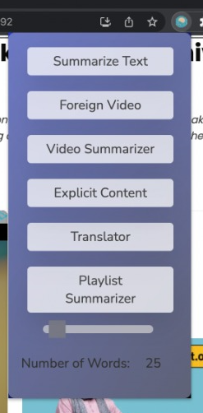
Implementation

Slide 5
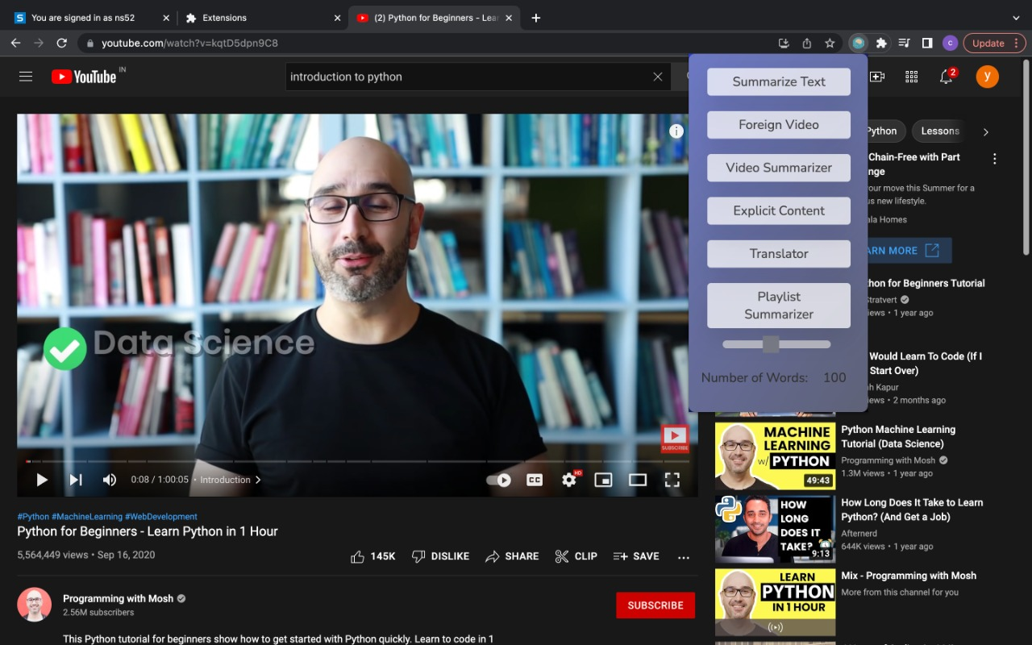
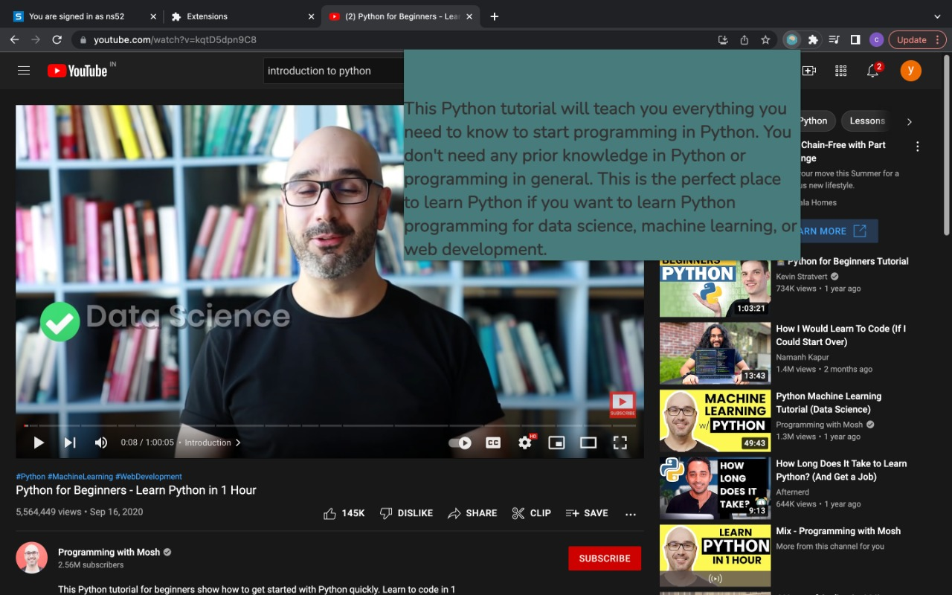
Implementation

Slide 6
Functionality of the Project
MongoDB
Django
The main interface of this project is a Google Chrome extension which is light and portable.
The synergetic amalgamation of HTML, CSS and JavaScript to provide the users with a cohesive interface.
The backend has been implemented using Python and has been connected to the extension using flask.
The backend relies on BeautifulSoup for web scraping and data extraction.
The summarization has been carried out using HuggingFace transformers.
Python

Slide 7
Future scope:
Integrate these functionalities with a fully fledged web extension.
Potentially host a server that takes care of the heavy lifting for the user to enhance their online experience.

Slide 8
Thank You
Wakanda Forever

